Slide 1
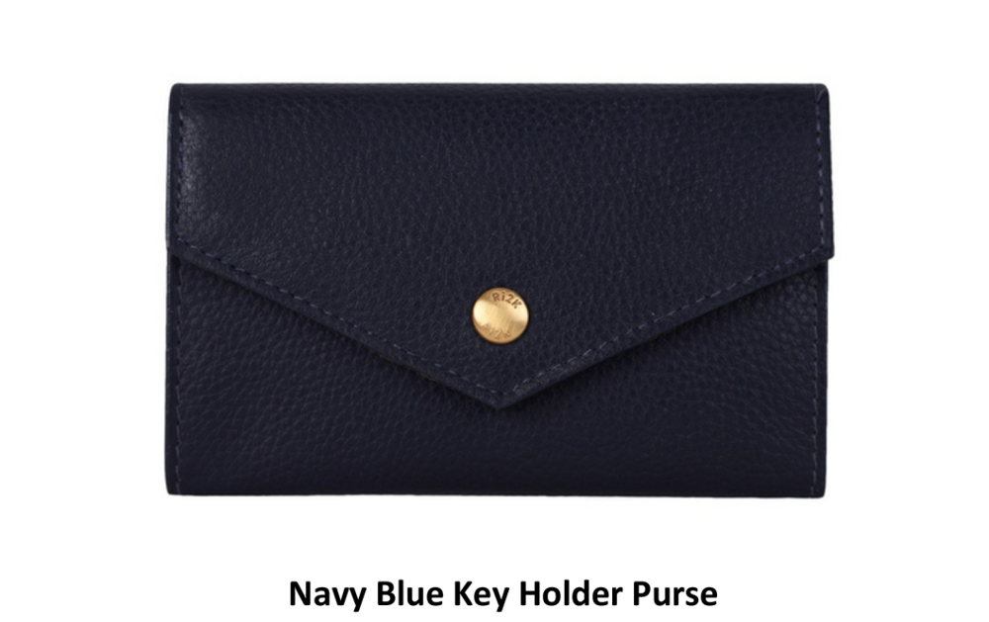
Product Name: ____________________________
Classic black purse with detailed inner compartments and zipped coin pocket.

Slide 2
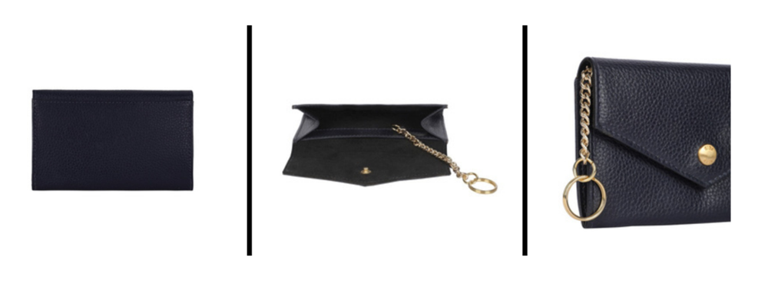
Product Name: ____________________________
Elegant design with quilted finish, featuring gold-tone accents.

Slide 3
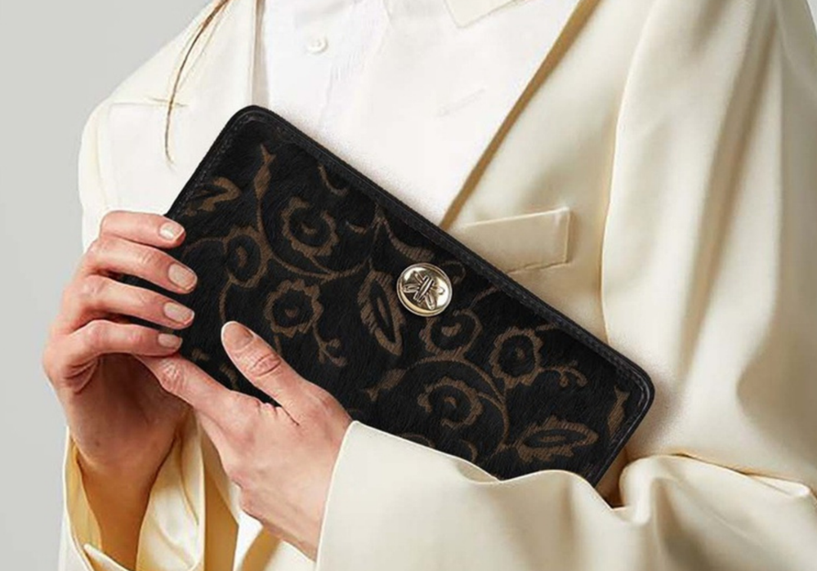
Product Name: ____________________________
Spacious interior with stylish red inner lining for added flair.

Slide 4
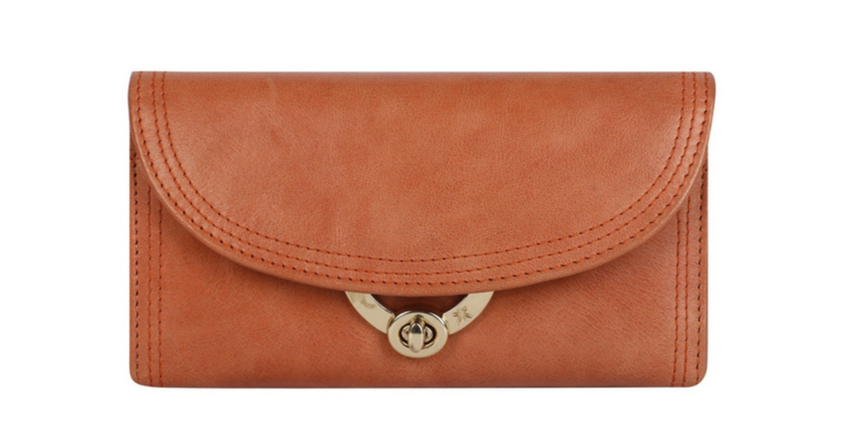
Product Name: ____________________________
Red and black textured zip purse – bold and vibrant.

Slide 5
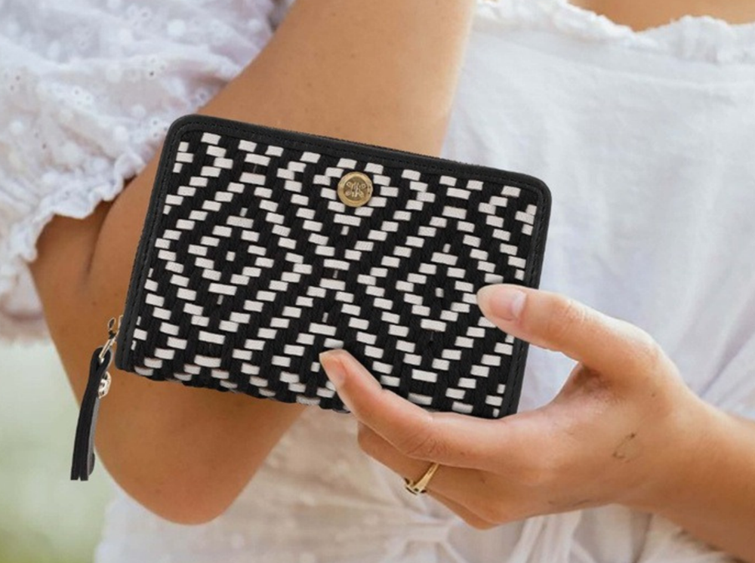
Product Name: ____________________________
Bohemian woven black & white purse, perfect for summer days.

Slide 6
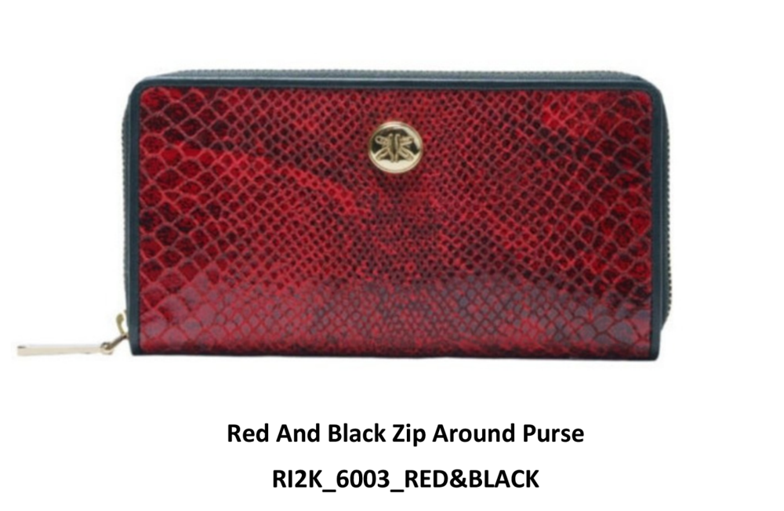
Product Name: ____________________________
Tan leather purse with a curved flap and golden turn-lock.

Slide 7
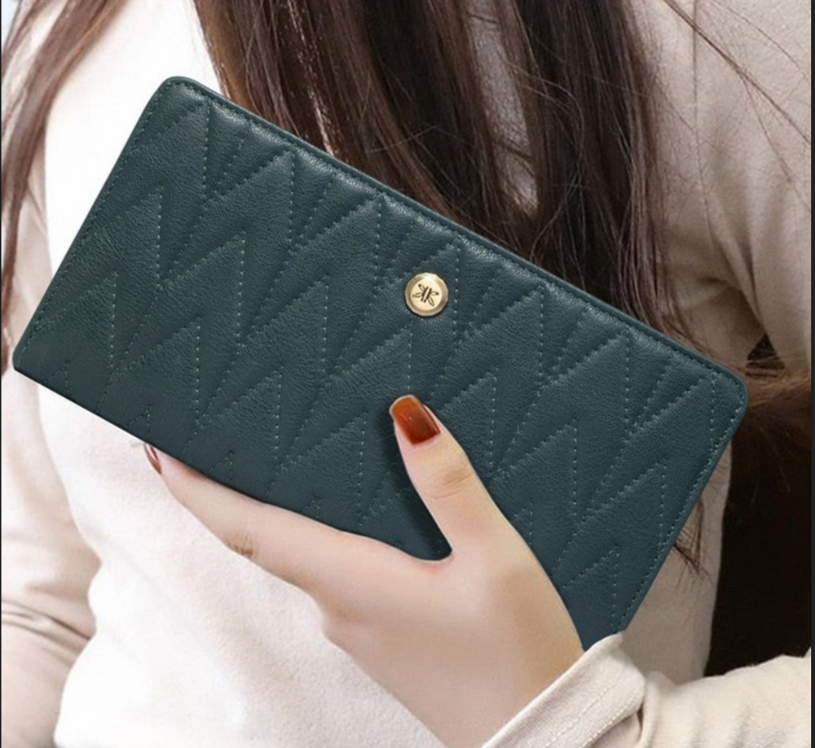
Product Name: ____________________________
Floral velvet finish for a touch of luxury and uniqueness.

Slide 8
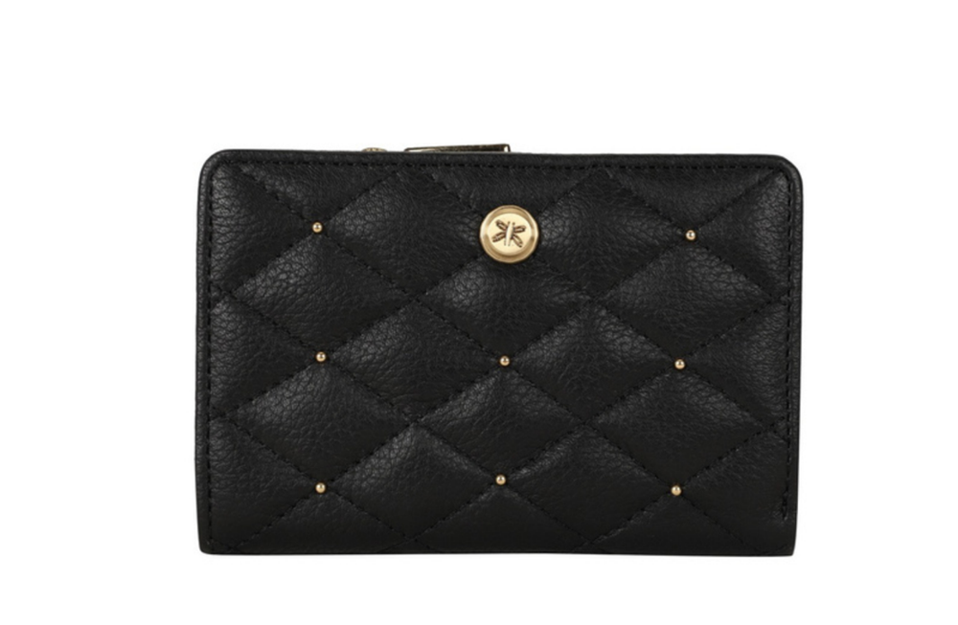
Product Name: ____________________________
Compact navy blue key holder with chain and press-stud closure.

Slide 9
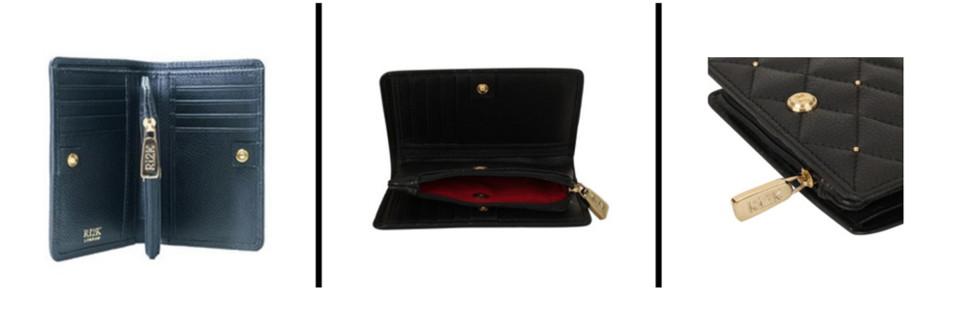
Product Name: ____________________________
Elegant and functional navy purse for carrying essentials with style.

